Slide 1
Behavioural Finance
3. Theoretical Foundations: Prospect Theory II & Heuristics
Antonio Silva, April 2023

Slide 2
Outline
Lesson 3
Prospect Theory recap
Narrow framing
Heuristics: Representativess

Slide 3
Rationality
Key Principles
Utility maximisation: Individuals are assumed to be rational, always making consistent decisions that maximize their utility.
Completeness: For any two options, A and B, an individual can rank them (A is preferred to B, B is preferred to A, or indifferent).
Transitivity: If option A is preferred to B and B is preferred to C, then A is preferred to C.
Independence: If A is preferred to B, then A should still be preferred to B even when both options are mixed with a third option, C, in the same proportion
Continuity: If A is preferred to B and B is preferred to C, there exists a probability mix between A and C that is equivalent in value to B
Notes:
Common misconceptions:
Not about doing what is best for “you”. Perfectly rational to sacrifice own food for your child, a kidney for your loved one.
We assume these things give you utility and you act in a way that maximises your own utility.
Transitivity If Steak > Chips, and Chips > Spinach, then Steak > spinach. Why must this hold? What happens if it doesn’t? (see money pump)
Behavioural economics is most concerned with violations of transitivity
For example, if people were handed a menu that listed three hot drinks, and they said that at some given moment they preferred coffee to tea, and tea to hot chocolate, they should logically prefer coffee to hot chocolate. If they preferred A to B and B to C, they should prefer A to C.
If people couldn't order their preferences logically, how would any market ever function properly? If people preferred coffee to tea and tea to hot chocolate—but then turned around and chose hot chocolate over coffee-they'd never finish choosing. They'd be willing, in principle, to pay to switch from hot chocolate to tea and also to switch from tea to coffee-and then pay again to switch from coffee to hot chocolate. They'd never settle on a drink but instead would be stuck in this mad infinite loop in which they kept paying to upgrade from the drink they had to a drink they liked better.

Slide 4
EUT deals with risk
Says that individuals should act in a certain way, when confronted with decision-making under uncertainty. Theory is really set up to deal with risk, not uncertainty.
Notes:
Risk is probabilities that are defined and correct. While uncertainty is a guess. In the real world often we deal with uncertainties, which is part of the reason why it’s not super useful in the real world. However, even when dealing with risk it sometimes doesn’t work.

Slide 5
Risk and uncertainty
Risk: when you know what the outcomes could be, and can assign probabilities
Uncertainty: when relevant information is unavailable and unknown. When you can’t assign probabilities; or you can’t come up with a list of possible outcomes

Slide 6
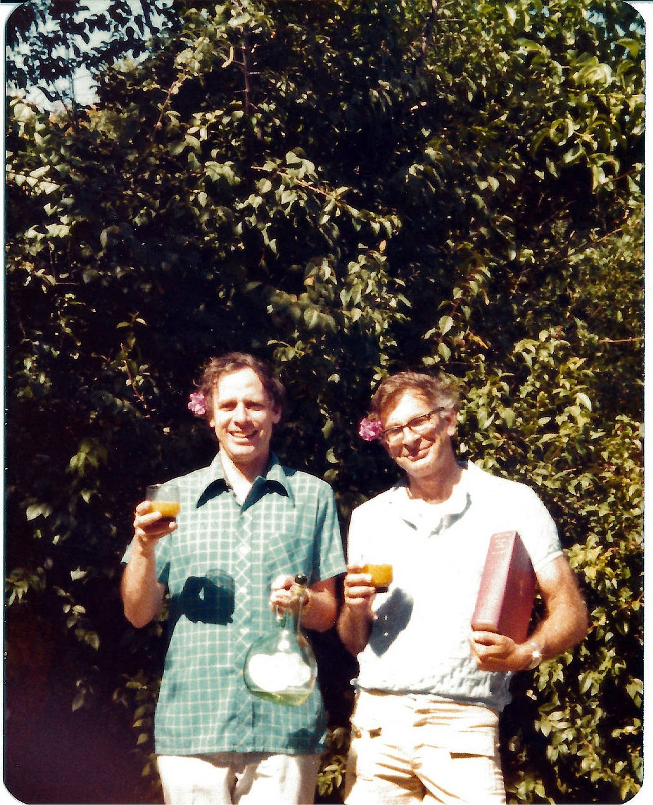
Prospect Theory
Background
EUT dominated the views of decision-making models, based on the pillars or rational choice and maximising expected utility. However, empirical observations and psychological experiments started to challenge these principles.
Prospect theory was developed by psychologists Daniel Kahnemann and Amos Tversky in 1979 in response to the limitations of EUT.
This model incorporated a broader set of psychological mechanisms underpinning human decision-making, based on how people actually behaved in the real-world.
Broad influence across a range of fields, from finance and economics to political science and public policy. Led Daniel Kahneman to win the Nobel in economics in 2022 - first non-economist to win it.
Notes:
Most successful at capturing the experimental results
Not normative, but descriptive: it simply tries to capture people’s attitudes to risky gambles
Best-known alternative theory

Slide 7
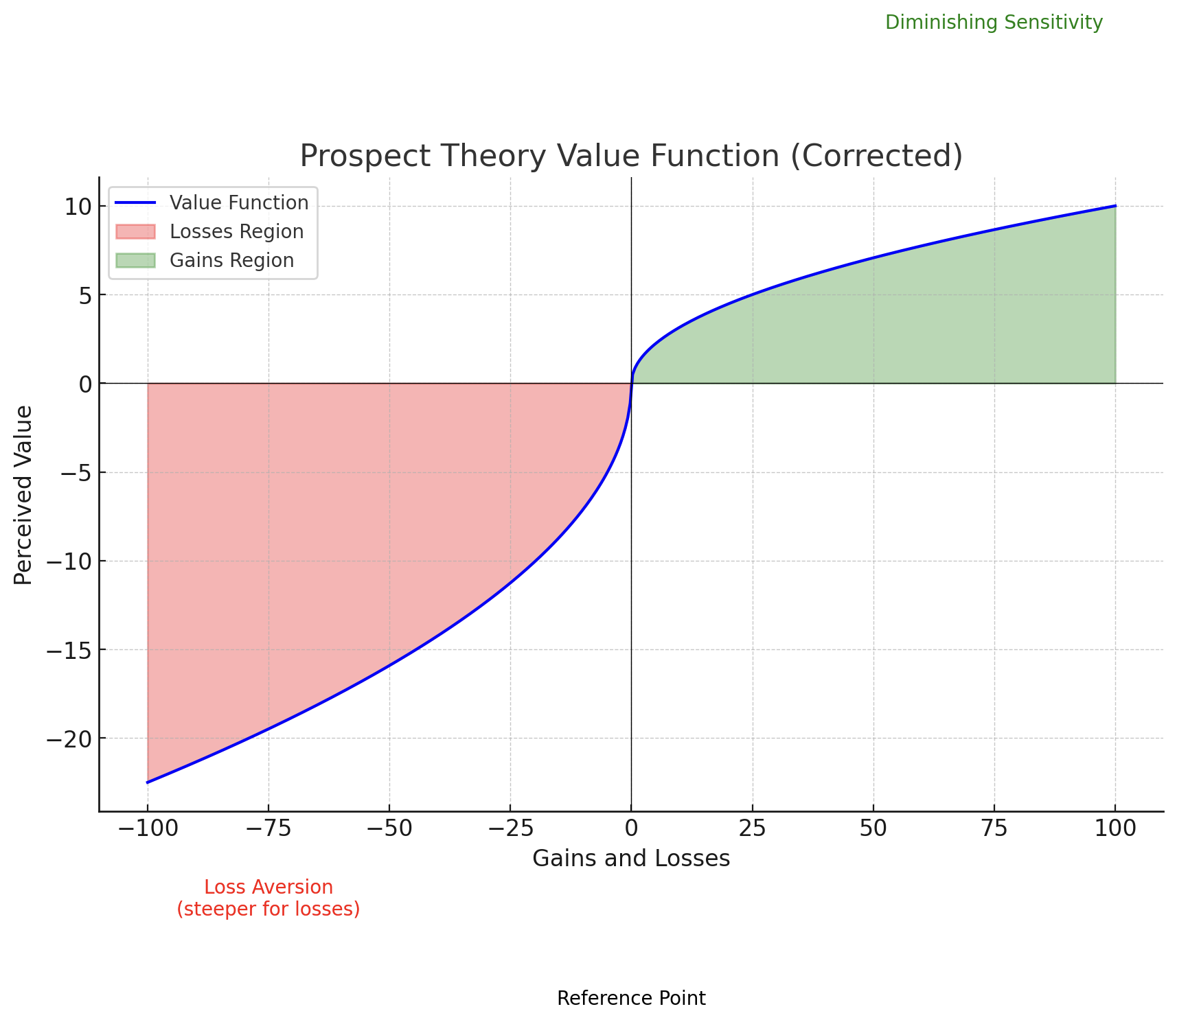
Prospect Theory
Value Function
Changes in wealth from a reference point (horizontal-axis) determine value (vertical-axis)
Concave in positive domain
Convex in negative domain
Steeper for losses
Notes:
So if you already have some Money, how much you’re going to value additional Money will be less.
Peoples are averse to losses because losses loom larger than equivalent gains. Hence the concave and convex utility function.

Slide 8
Prospect Theory
Problem 1 - Risk seeking vs aversion
Decision i) [84% P1]
P1(250€) or P2(0.25, 1000€)
Decision ii) [87% P4]
P3(-750€) or P4(0.75, -1000€)
People sometimes exhibit risk aversion and sometimes risk seeking, depending on the nature of the prospect. Sometimes the same person is risk averse or risk seeking, which means the utility function isn’t the same in all wealth points.
Notes:
First decision just shows people prefer certainty
P1 has the same EV as P2, but people choose the certain option. P3 has the same EV as P4. Yet people choose the risky option because its framed as a loss
So sometimes the same person is risk averse or risk lovin, so that means that the utility function isn’t the same in all wealth points.

Slide 9
Prospect Theory
Problem 2 - Reference point
Decision i) [72%P5]
Assume yourself richer by 300€. Then choose between:
P5(100€) or P6(0,50, 200€)
Decision ii) [64%P8]
Assume yourself richer by 500€. Then choose between:
P7(-100€) or P8(0,50, -200€)
Peoples’ valuation of prospects depend on gains and losses relative to a reference point, not in final wealth. The reference point is usually the status quo.
Notes:
They are identical, yet people flip their choices because of the change to the reference point

Slide 10
Prospect Theory
Problem 3 - Loss loom larger than gains
What value of x would make you indifferent between?
P9(0€) or P10(0.5, x;-25€)
Average response is €61, which has a much higher EV than P9
Peoples are averse to losses because losses loom larger than equivalent gains. Hence the concave utility function.

Slide 11
Prospect Theory
Problem 4 - Certainty effect
Decision i) [80% P16]
P15(0.8, 4000€) or P16(3000€)
Decision ii) [65% P17]
P17(0.2, 4000€) or P18(0.25, 3000€)
Decision ii) is similar to i)
Discontinuity when probability is 1.
Notes:
Divided both by 4, yet it flips. And it flips because of certainty. Discontinuity because you are (nearly) infinitely risk averse specifically at the probability of 1 i.e. certainty
The substitution axiom of utility theory asserts that if B is preferred to A, then any (probability) mixture (B, p) must be preferred to the mixture (A, p). Our subjects did not obey this axiom. Apparently, reducing the
probability of winning from 1.0 to .25 has a greater effect than the reduction from .8 to .2.

Slide 12
Prospect Theory
Problem 5 - Overweighing low probability events
P11(0.001, 5000€) ≻ P12(5€)
Equal expected values of prospects
Choice means risk seeking in the domain of gains
Risk aversion in the positive domain shifts to risk seeking with very low probabilities
People overweight low-probability events
Notes:
Explains lottery: the expected payoff is less than the price of a ticket

Slide 13
Prospect Theory
Problem 5 - Overweighing low probability events
P13(0.001, -5000€) ≺ P14(-5€)
Equal expected values of prospects
Choice means risk aversion in the domain of losses
People overweight low-probability events
Notes:
Explains insurance

Slide 14
Prospect Theory
Problem 6 - Overweighting of low probabilities is greatest at the lowest probabilities
Decision i)
P19(0.45, 6000€) ≺ P20(0.90, 3000€)
Decision ii)
P21(0.001, 6000€) ≻ P22(0.002, 3000€)
Decision ii) is similar to decision i)
Notes:
As another example, people are willing to pay the same for 1% chance of a million, as 2% of a million, despite the second having double the EV.

Slide 15
Prospect Theory
Value Function
The value function replaces the utility function in EUT. The 3 key aspects of decision-making suggest:
People exhibit risk aversion in the positive domain and risk seeking in the negative domain; value function is concave in the positive domain and convex in the negative domain
Decisions are made by focusing on gains and losses; the argument for the value function changes in gains and losses
People dislike losses; the value function is steeper for losses than for gains

Slide 16
Prospect Theory
Value Function
Changes in wealth from a reference point (horizontal-axis) determine value (vertical-axis)
Concave in positive domain
Convex in negative domain
Steeper for losses

Slide 17
“The term frame dependence means that the way people behave depends on the way that their decision problems are framed.” Shefrin (2000)
“Framing is a cognitive heuristic in which people tend to reach conclusions based on the 'framework' within which a situation was presented” Tverksy & Kahneman (1981)

Slide 18
Narrow Framing
Neoclassic theory: The agent has capacity to evaluate each gamble, assess risk and choose most attractive option.
Behavioural theory: The agent evaluates each gamble in isolation, separating them from other risks.

Slide 19
Narrow Framing
Definition
Narrow framing is the tendency of individuals to make decisions without considering all the alternatives or implications. They view decisions in isolation rather than as part of a broader context. This bias can lead to sub-optimal decisions because the decision-maker fails to integrate the decision into a comprehensive assessment of their overall situation or the total portfolio of choices.

Slide 20
Narrow Framing
Examples
Investment Decisions: An investor might evaluate each investment opportunity independently without considering how the investment fits into their overall portfolio. This could lead to an unbalanced portfolio that is either too risky or too conservative compared to the investor's overall investment goals and risk tolerance.
Consumer Purchases: A consumer deciding whether to buy an item might consider only the immediate cost and benefits of that purchase, ignoring how this expenditure fits into their broader financial plan or budget. This could lead to spending that is inconsistent with long-term financial goals.

Slide 21
Narrow Framing
Insurance
Should you buy insurance? Yes, if price is less than expected damage
However:
  Biased evaluation of probabilities
  Biased evaluation of losses
  Wrong perception of risk
  Framing effect in evaluation of costs and benefits

Slide 22
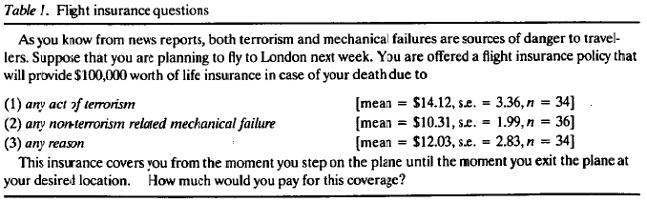
Narrow Framing
Risk perception
Systematic distortion of probability and risk -> distortion of prices
Flight insurance example (Johnson et al,1993):
:

Slide 23
Narrow Framing
Framing effects
Aversion to deductibles in auto insurance
Moral hazard->most insurance policies don’t completely shift risk to the insurer
Deductibles: the insured pays a fixed amount for each loss
Consumers dislike deductibles, even when those policies offer considerable savings –> consumers frame deductibles as an isolate loss (narrow framing and loss aversion)
Behavioural insurance policy: the deductible is incorporated in the cost of insurance (by raising rates) and an incentive for consumers to avoid accidents is provided by a rebate
Notes:
Insurance premiums can involve complex streams of transactions, with some descriptions of premiums being more attractive than others
a moral hazard is a situation where an economic actor has an incentive to increase its exposure to risk because it does not bear the full costs of that risk. For example, when a corporation is insured, it may take on higher risk knowing that its insurance will pay the associated costs.

Slide 24
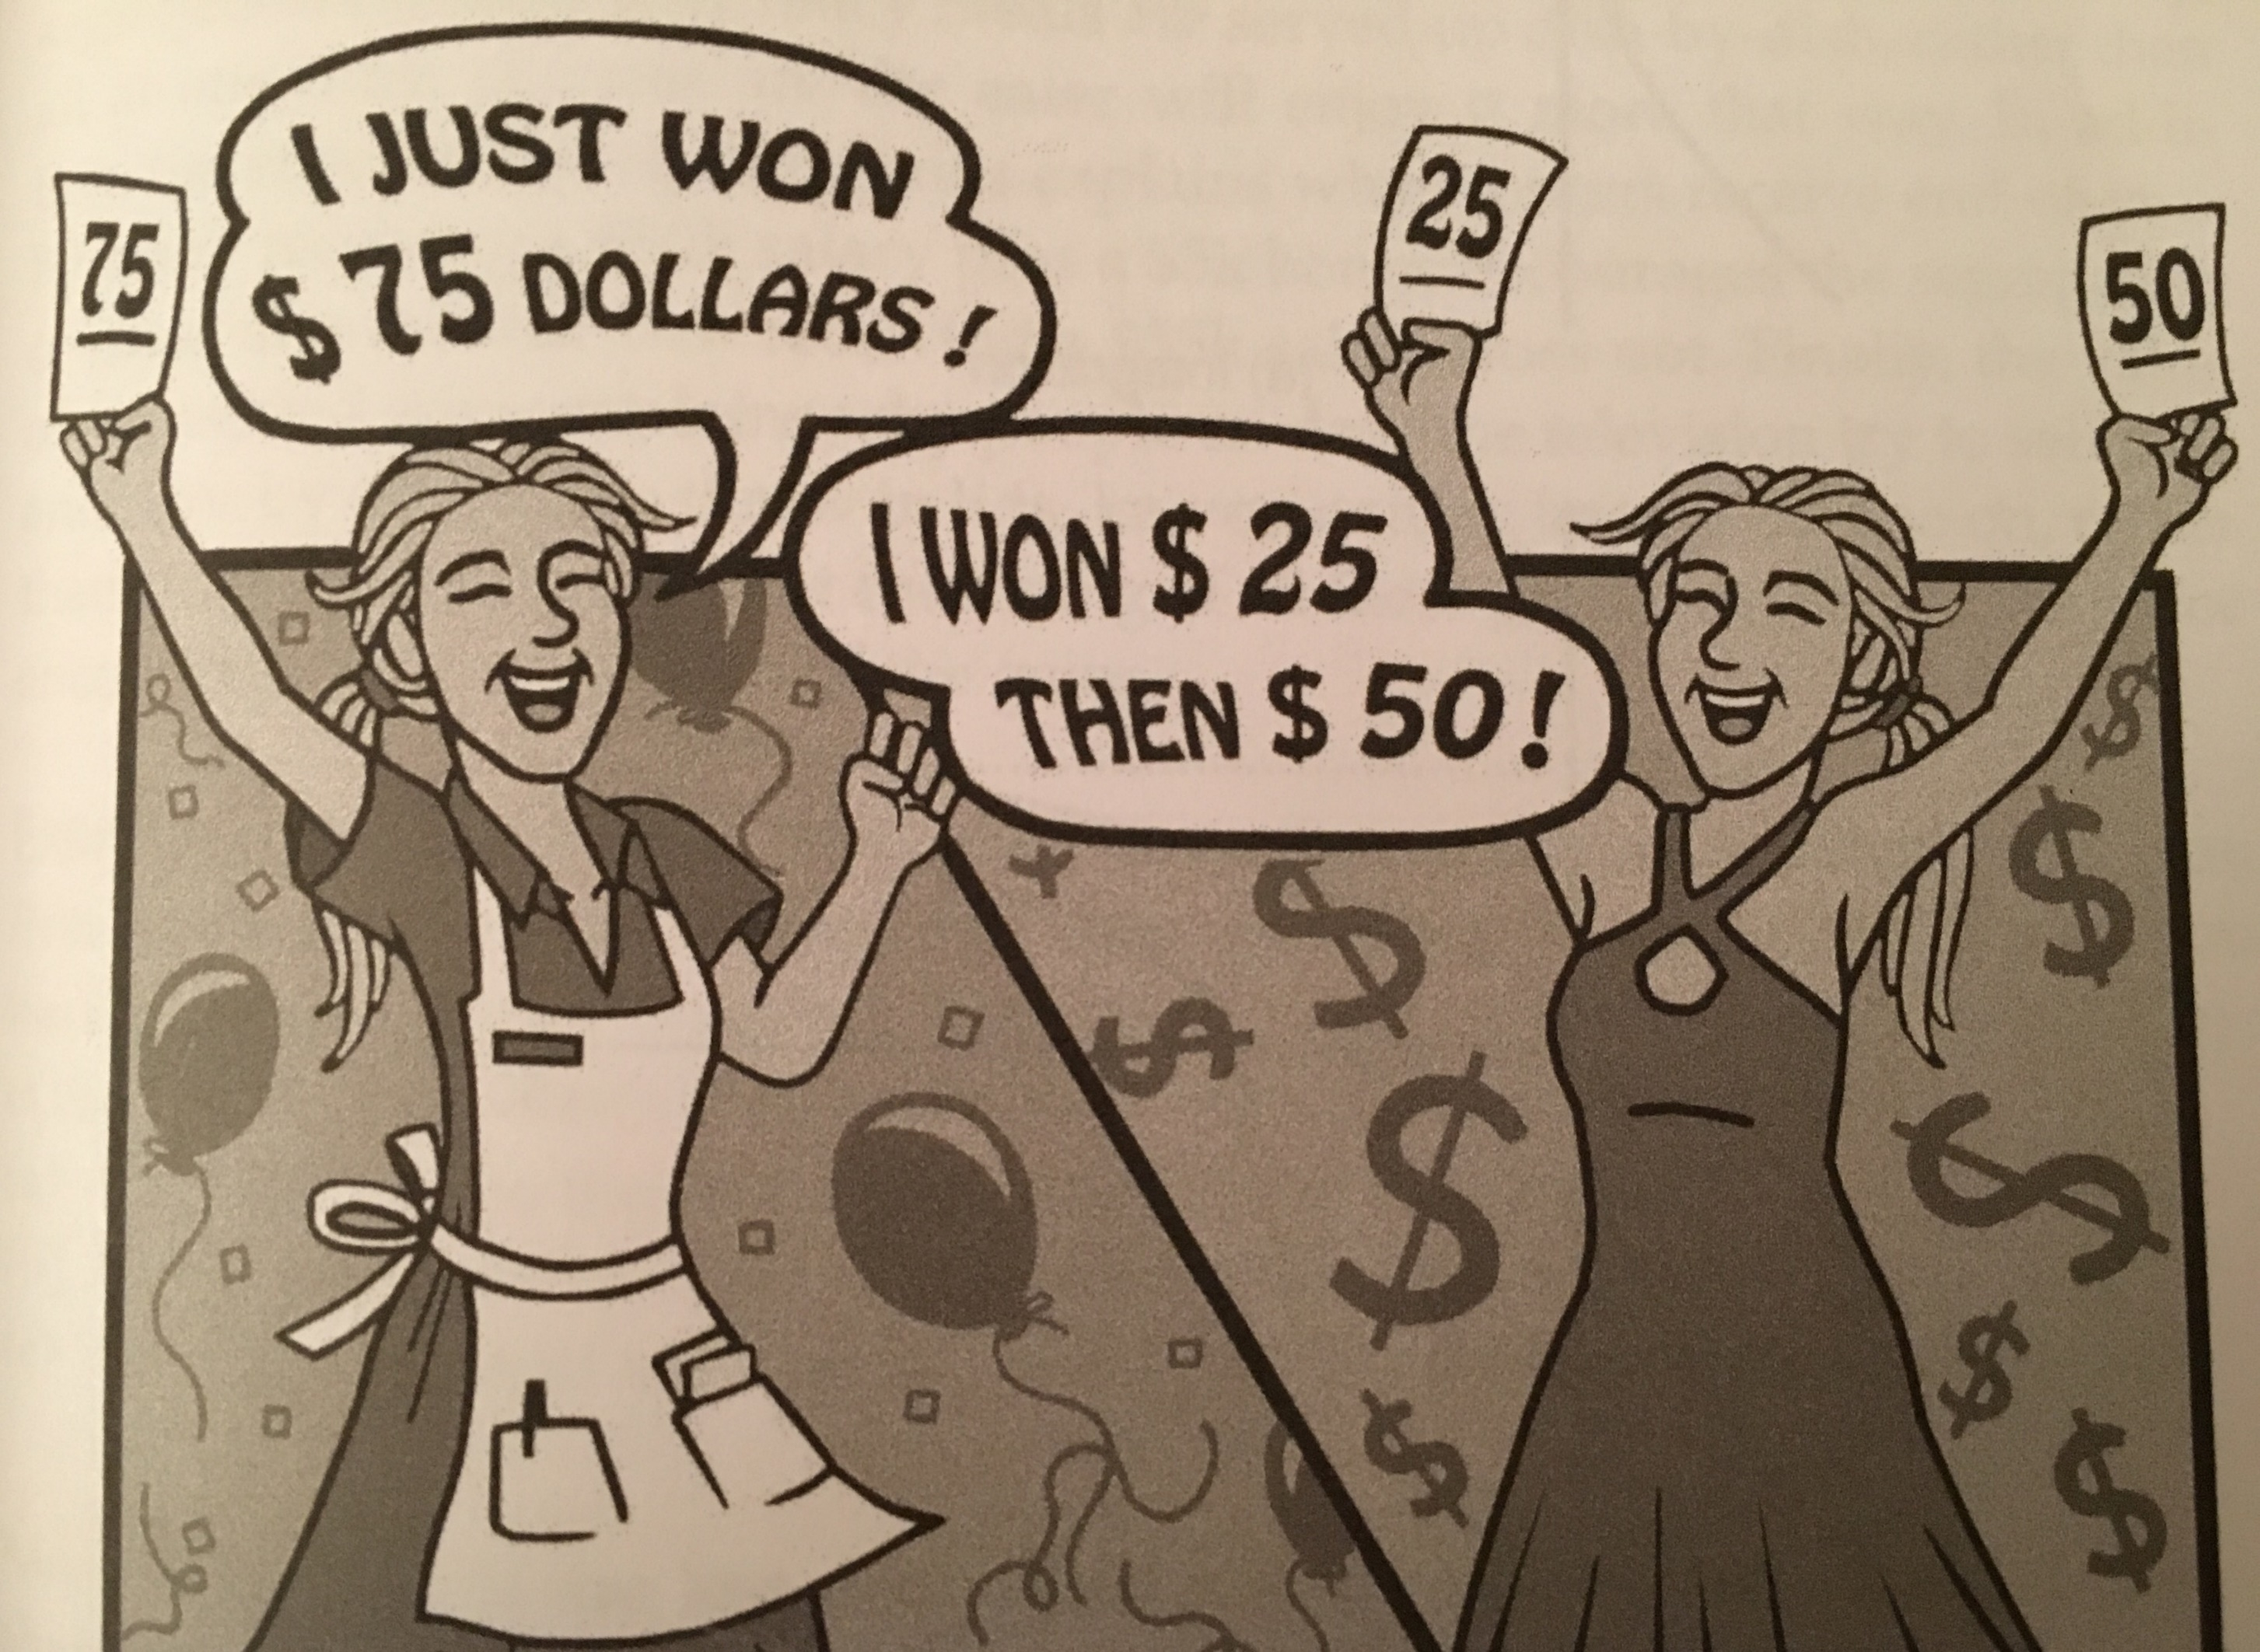
Bundling
Integration and segregation relate to how choices are bundled or grouped together and how this affects individuals' evaluations of those choices.
People perceive and assess the total value of a set of options when presented as a bundle vs when presented separately.

Slide 25
Bundling
Gains
v(75): integration
v(25) + v(50): segregation
What are the implications in terms of value?

Slide 26
Bundling
Integration value function
v(x)
v(75)
+25
+50
+75
x
Notes:
The slope shows how valuable each euro is and because dimishing returns, each marginal euro has less value. The most impactful euro is the first euro, you can see the steepness of the curve at the beginning right.

Slide 27
Bundling
Segregation value function
v(x)
v(50)
v(25)
+25
+50
x
Notes:
So separation is always better because you get the beginning part always. In integration you can only move along the curve. In segregation you are not moving along the curve, you’re getting a new curve every time.

Slide 28
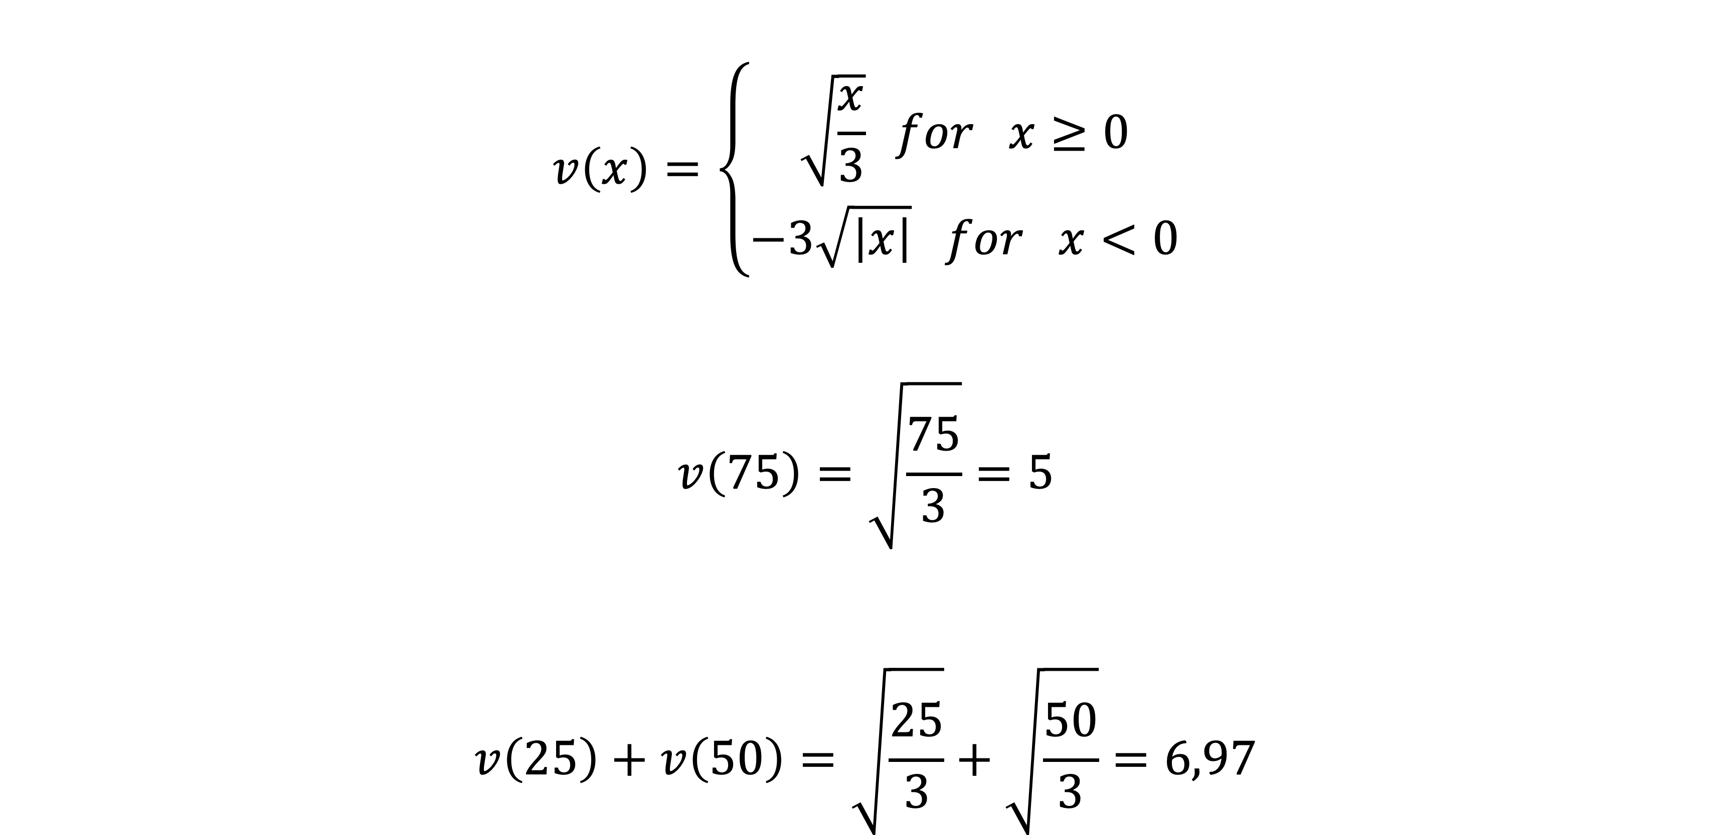
Bundling
Value Function - Gains
$$v\left(x\right)=\left\{\begin{aligned}\sqrt{\frac{x}{3}} for x≥0 \\ −3\sqrt{\left|x\right|} for x<0\end{aligned}\right.$$
$$v\left(75\right)=\sqrt{\frac{75}{3}}=5$$
$$v\left(25\right)+v\left(50\right)=\sqrt{\frac{25}{3}}+\sqrt{\frac{50}{3}}=6,97$$
Notes:
We move along the reference point

Slide 29
Bundling
Losses
v(-75): integration
v(-25) + v(-50): segregation
What are the implications in terms of value?

Slide 30
Bundling
Integration value function
v(x)
-75
-50
-25
x
v(-75)

Slide 31
Bundling
Segregation value function
v(x)
-50
-25
x
v(-25)
v(-50)
Notes:
Now in losses segregation is worse because you get the worst bit multiple times. The curve in losses is convex and steeper. So each additional loss leads to greater loss than the previous one

Slide 32

Bundling
Value Function - Losses
$$v\left(x\right)=\left\{\begin{aligned}\sqrt{\frac{x}{3}} for x≥0 \\ −3\sqrt{\left|x\right|} for x<0\end{aligned}\right.$$
$$v\left(−75\right)=−3\sqrt{75}=−25,98$$
$$v\left(−25\right)+v\left(−50\right)=−3\sqrt{25}−3\sqrt{50}=−15−21,213=−36,213$$
Notes:
We move along the reference point

Slide 33
Bundling
Tendency to:
Segregate in case of gains
Integrate in case of losses
“The death of one man is a tragedy, the death of millions is a statistic”

Slide 34
Imagine you have decided to see a play where admission is 10€. As you enter theater you discover that you have lost a 10€ bill. Would you pay 10€ for a ticket to the play?
Imagine that you have decided to see a play and paid the admission price of 10€ per ticket. As you enter the theater you discover that you have lost the ticket. Would you pay 10€ for another ticket?

Slide 35
Imagine you have decided to see a play where admission is 10€. As you enter theater you discover that you have lost a 10€ bill. Would you pay 10€ for a ticket to the play?
Imagine that you have decided to see a play and paid the admission price of 10€ per ticket. As you enter the theater you discover that you have lost the ticket. Would you pay 10€ for another ticket?

Slide 36
Imagine you have decided to see a play where admission is 10€. As you enter theater you discover that you have lost a 10€ bill. Would you pay 10€ for a ticket to the play? 88% said Yes
Imagine that you have decided to see a play and paid the admission price of 10€ per ticket. As you enter the theater you discover that you have lost the ticket. Would you pay 10€ for another ticket? 46% said Yes

Slide 37
Mental accounting
In scenario B, integration is more likely because both lost ticket and new ticket would be from same “account.” We consider v(-20) while in option A we don´t.
Integration might suggest that 20€ is too much for the ticket.

Slide 38
Heuristics & Behavioural biases
Notes:
Emphasise that this is not the model, but the mean. So as if you played a million times. You win a pound if head, zero if head. Whats the expected value? 0

Slide 39

Heuristics
Behavioural Bias
Representativeness
Cognitive Bias
Availability
Emotional Bias
Anchoring
Social-cultural bias
Affect
Behavioural Finance | Sandra Maximiano Lecture 4|Nov 11 2021
Notes:
The first 3 can lead to biases and systematic errors
The 4th relates to how people feel.

Slide 40
Heuristics
Simple rules that people use to help increase the speed of making decisions and forming judgments.
Strategies that provide shortcuts to problem-solving and decisions taking past experiences into account.
Notes:
Have you ever made a decision based on an educated guess, rule of thumb, or common sense?

Slide 41
Behavioural biases
Research of behavioural biases – cognitive, emotional, and social-cultural – helps to explain errors in economic decision-making and to predict the behaviour, which helps avoiding future errors.
Notes:
Heuristics tend to be neutral, sometimes good, sometimes bad depending on the context. They lead to biases which tend to have negative outcomes. When heuristics lead to systematic errors they are are categorised ad biases

Slide 42


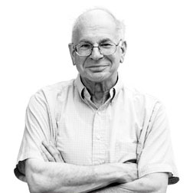
System 1 vs System 2
Biases
Emotions
System 2
Slow thinking/Reflective deliberate, analytic
24x17
Planning a trip overseas
Intuition
System 1
Fast thinking/Automatic intuitive, effortless
2x2
Taking your daily commute
Daniel Kahneman,
Nobel Laureate
Social Influence
Heuristics
Notes:
A growing body of psychological research divides our decision-making into two systems. System 1 thinking is fast, effortless, automatic and largely involuntary - the kind of thinking that we use to take our daily commute or to react when we hear a loud noise. By contrast, System 2 is more deliberative, effortful, attentive, and voluntary. System 2 thinking is used to undertake complex thought processes like writing a job application or deciding which school to send our children. Both systems are important for getting through life effectively and efficiently but we are increasingly learning that System 1 thinking can sometimes lead us astray and we have limited capacity for System 2 thinking.
Intuition – Aggregate of past experience and assumptions
Mental short-cuts – we’re fast and frugal thinkers, using rules-of-thumb and instinct a lot of the time, rather than careful deliberation
Emotions – choices are often made on their emotional resonance, not deliberate logic
Social influence – we social creatures, often conforming to the masses, and use others as a source of information.
Biases – stereotypes, assumptions, and our tendencies to focus on some aspects of a situation and ignore others, our tendency to ignore information that doesn’t support our pre-existing opinions and beliefs.

Slide 43
Ana invested €8000 in the stock market early in 2008.
Six months after she invested, on July 17, the stocks she had purchased were down 50%. Fortunately, for Ana, from July 17 to October 17, the stocks she had purchased went up 75%. At this point, Ana has:
Broken even in the stock market
Is ahead of where she began
Has lost money

Slide 44
If your immediate answer is b, you aren’t alone.
The incorrect System 1 intuitive answer is b, because 75% is greater than 50%, but by using System 2, we find that the initial €8000 declined by 50% to €4000, before increasing by 75%, to €7000, still short of €8000.

Slide 45
A bat and a ball cost €1.10 in total. The bat costs €1.00 more than the ball. How much does the ball cost?

Slide 46
A bat and a ball cost €1.10 in total. The bat costs €1.00 more than the ball. How much does the ball cost?
Intuitively people respond 10 cents but if the ball cost 10 cents and the bat costs €1.00 more than the ball, then the bat would cost €1.10 for a grand total of €1.20. The correct answer to this problem is that the ball costs 5 cents and the bat costs — at a euro more — €1.05 for a grand total of €1.10.

Slide 47
“If there is time to reflect, slowing down
is likely to be a good idea.”
Daniel Kahneman, ‘Thinking, Fast and Slow’

Slide 48
Heuristics can be beneficial
Heuristics helps to avoid paralysis by analysis, which is the state of over-thinking and over-analysing. Often heuristics are useful, e.g. brands you recognise are more likely to be of higher quality

Slide 49
Heuristics vs probability theory
Decision-makers often face a set of choices with uncertainty. If they were fully rational, they will use probability theory. However, they have a limited ability to quantify the likelihood of the results.
Notes:
Heuristics are particularly useful when accurate information is costly, time consuming or not easily available. In such contexts, recognition heuristics for exemple is a reliable indicator of quality

Slide 50
Risk and uncertainty
Risk: when you know what the outcomes could be, and can assign probabilities
Uncertainty: when relevant information is unavailable and unknown. When you can’t assign probabilities; or you can’t come up with a list of possible outcomes
Notes:
Remember this slide. Heuristics are useful in uncertain environments where we can’t calculate risk correctly.

Slide 51
Heuristics
Examples
Authority heuristic: When someone believes the opinion of a person on a subject just because the individual is an authority figure.
Past performance heuristic: Investors choose funds based on past performance. Using past risk-adjusted performance to guide investment decisions might work in very short time periods, but there is little consistency in predictive ability beyond this short-term horizon.
Recognition heuristic: If one of two objects is recognised and the other is not, the recognised one has higher value

Slide 52
Representativeness
Psychological (cognitive) biases
Availability
Anchoring
Affect
Emotions
Behavioural Finance | Sandra Maximiano Lecture 3|Nov 9 2021
Notes:
There are 4 general categories of heurististics.
The first 3 can lead to biases and systematic errors
The 4th relates to how people feel.

Slide 53
Representativeness
Psychological (cognitive) biases
Availability
Anchoring
Affect
Emotions
Behavioural Finance | Sandra Maximiano Lecture 3|Nov 9 2021
Notes:
There are 4 general categories of heurististics.
The first 3 can lead to biases and systematic errors
The 4th relates to how people feel.

Slide 54
How does the representativeness heuristic influence judgment and decision-making?

Slide 55
Example
«Jack is a 45-year-old man and shy”
Is Jack a salesman or a librarian?
Behavioural Finance | Sandra Maximiano Lecture 3|Nov 9 2021
Notes:
It is reasonable

Slide 56
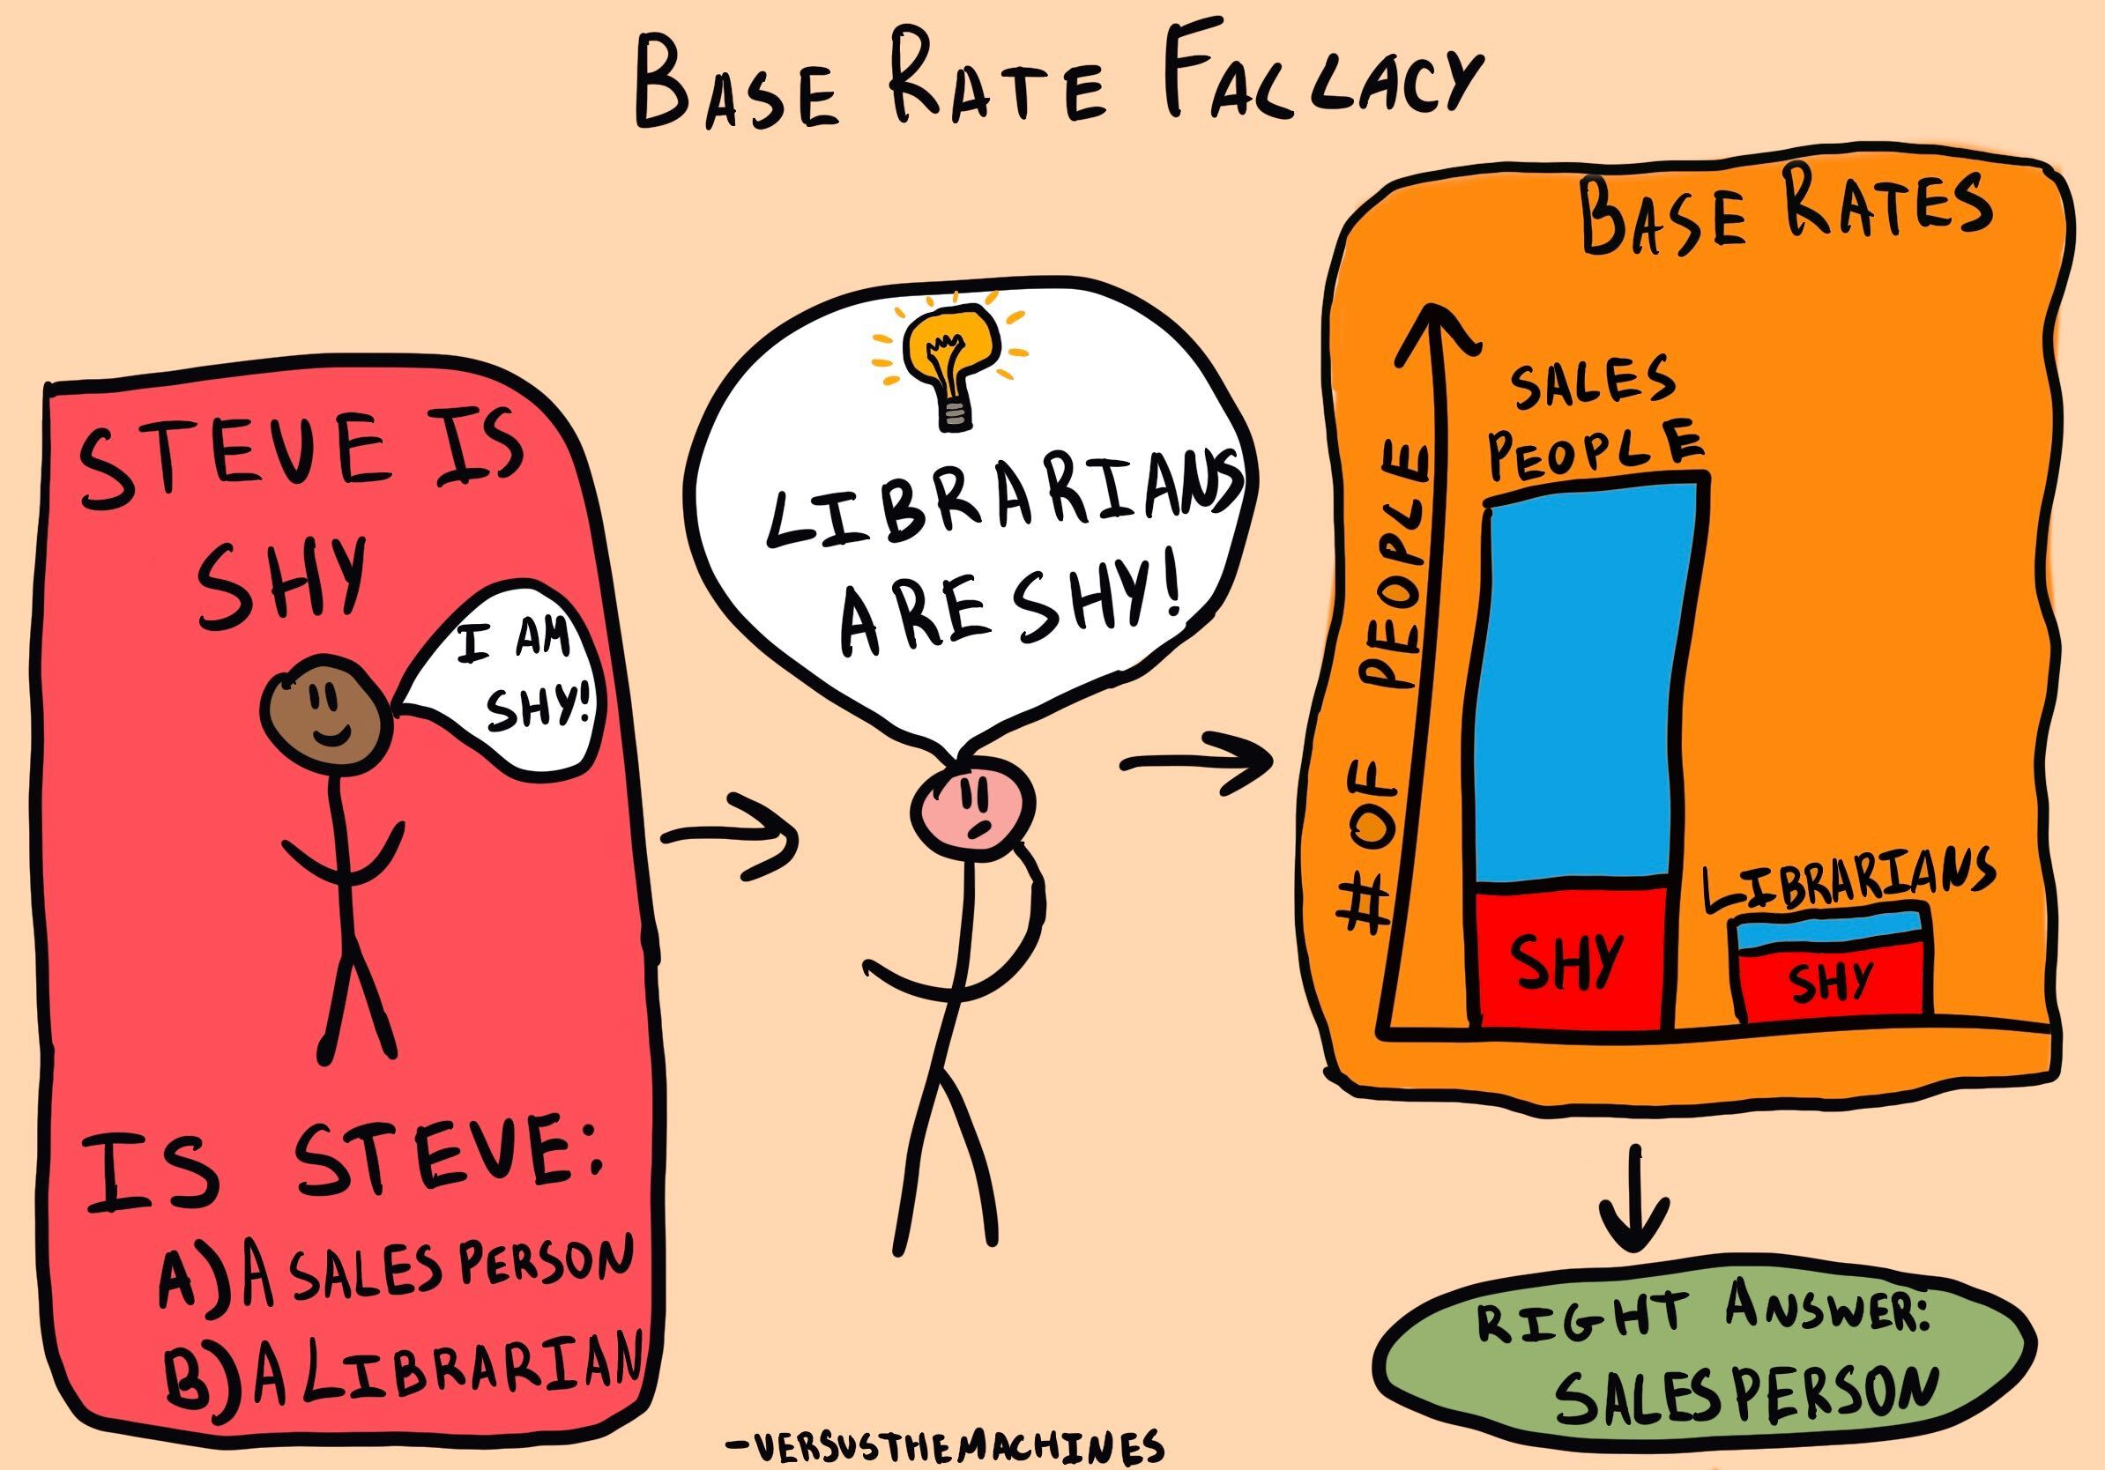
Behavioural Finance | Sandra Maximiano Lecture 3|Nov 9 2021

Slide 57
Representativeness heuristic
The representativeness heuristic is the tendency to use past experiences or beliefs to guide the decision-making process and ignore prior probabilities of outcomes
When people are asked to judge the probability that an object or event A belongs to class or process B, probabilities are evaluated by the degree to which A is representative of B, that is, by the degree to which A resembles B.
Notes:
The degree that being shy is representative of being a librarian.

Slide 58
Example
Suppose that the rate of disease D is 3x higher among homosexuals than among heterosexuals - the % of homosexuals who have D is 3x the % of heterosexuals who have it.
Suppose that J is diagnosed with the disease and this is all that you know about J. In particular, you don't know anything else about J's sexual orientation; in fact, you don't even know whether J is male or female.
What is the likelihood that J is homosexual?
Behavioural Finance | Sandra Maximiano Lecture 3|Nov 9 2021
Notes:
It is reasonable

Slide 59
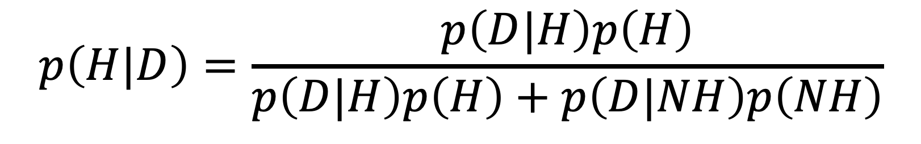
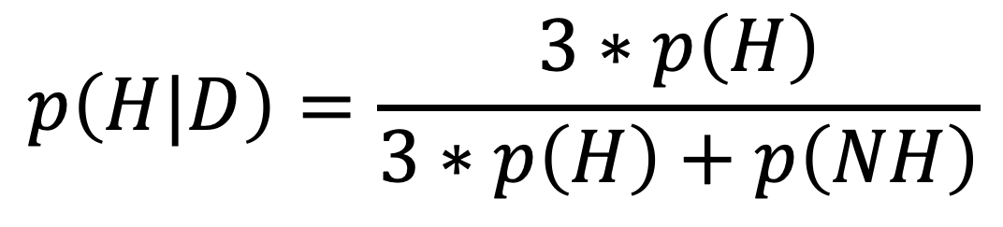
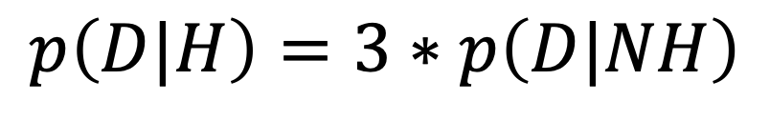
What is the likelihood that J is homosexual?
“H” the proposition that J. is homosexual
“D” the proposition that J. has the disease
$$p\left(H|D\right)=\frac{p\left(D|H\right)p\left(H\right)}{p\left(D|H\right)p\left(H\right)+p\left(D|NH\right)p\left(NH\right)}$$
$$p\left(D|H\right)=3∗p\left(D|NH\right)$$
People tend to think that the likelihood that J is homosexual is much higher than 25%.
Most people guess 75% based on the fact that the rate of the disease is 3x higher among homosexuals.
$$p\left(H|D\right)=\frac{3∗p\left(H\right)}{3∗p\left(H\right)+p\left(NH\right)}$$
p(H)= 10% ➔ p(H|D)= 25%
p(H)= 5% ➔ p(H|D)= 14%
Notes:
So you can see how this can lead to problematic biases and discrimination

Slide 60
Base rate neglet
People's tendency to neglect existing knowledge about a phenomenon when evaluating new information.
Behavioural Finance | Sandra Maximiano Lecture 3|Nov 9 2021
Notes:
It is reasonable

Slide 61
Example
A town is served by 2 hospitals. In the larger hospital about 45 babies are born each day, and in the smaller hospital about 15 babies are born each day. As you know, about 50% of all babies are boys. However, the exact percentage varies from day to day. Sometimes it may be higher than 50%, sometimes lower. For a period of 1 year, each hospital recorded the days on which more than 60% of the babies born were boys. Which hospital do you think recorded more such days?
  The larger hospital
  The smaller hospital
  About the same
Behavioural Finance | Sandra Maximiano Lecture 3|Nov 9 2021
Notes:
It is reasonable

Slide 62
Insensitivity to sample size
Most people incorrectly choose C. The correct answer is B
Most individuals choose C, expecting the 2 hospitals to record a similar number of days on which 60% or more of the babies born are boys. Statistics tells us that we are much more likely to observe 60% of male babies in a smaller sample than in a larger sample.
Think about which is more likely: getting more than 60% heads in 3 flips of coin or getting more than 60% heads in 3,000 flips?
Behavioural Finance | Sandra Maximiano Lecture 3|Nov 9 2021
Notes:
It is reasonable

Slide 63
Example
Imagine a family with six children, what’s the most likely birth order?
A. Boy Girl Boy Boy Boy Boy
B. Girl Boy Girl Boy Boy Girl.
Behavioural Finance | Sandra Maximiano Lecture 3|Nov 9 2021
Notes:
For instance, in families with six children, the birth order B G B B B B was about as likely as G B G B B G. But Israeli kids-like pretty much everyone else on the planet, it would emerge —naturally seemed to believe that G B G B B G was a more likely birth sequence.
Why? "The sequence with five boys and one girl fails to reflect the proportion of boys and girls in the population," they explained.
It was less representative. What is more, if you asked the same Israeli kids to choose the more likely birth order in families with six children —B B B G G G or G B B G B G- they overwhelmingly opted for the latter. But the two birth orders are equally likely. So why did people almost universally believe that one was far more likely than the other? Because, said Danny and Amos, people thought of birth order as a random process, and the second sequence looks more
"random" than the first.

Slide 64
Misconception of chance
People expect that a sequence of events generated by a random process will represent the essential characteristics of that process
Notes:
people thought of birth order as a random process, and the second sequence looks more "random" than the first.

